Slide 1
Faster Asset Creation Pipeline in Solo Game Development
Alex Banning

Slide 2
The Problem
Small studios and solo devs have less resources and manpower
Asset creation is the most time-consuming part of game dev
Difficult Tradeoff:
Perfect custom assets = lots of time and money
Buying assets loses soul and makes games look alike

Slide 3
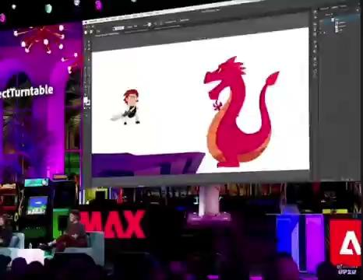
Potential Solutions -
Adobe Illustrator (Project Neo Beta)
Used predominantly for graphic design
How can we leverage this for game design?
Sprite creation and simple animation
Potential risks?
Difficult to make anything asymmetrical
Tradeoff: Less control but saves time
Hybrid implementation?

Slide 4
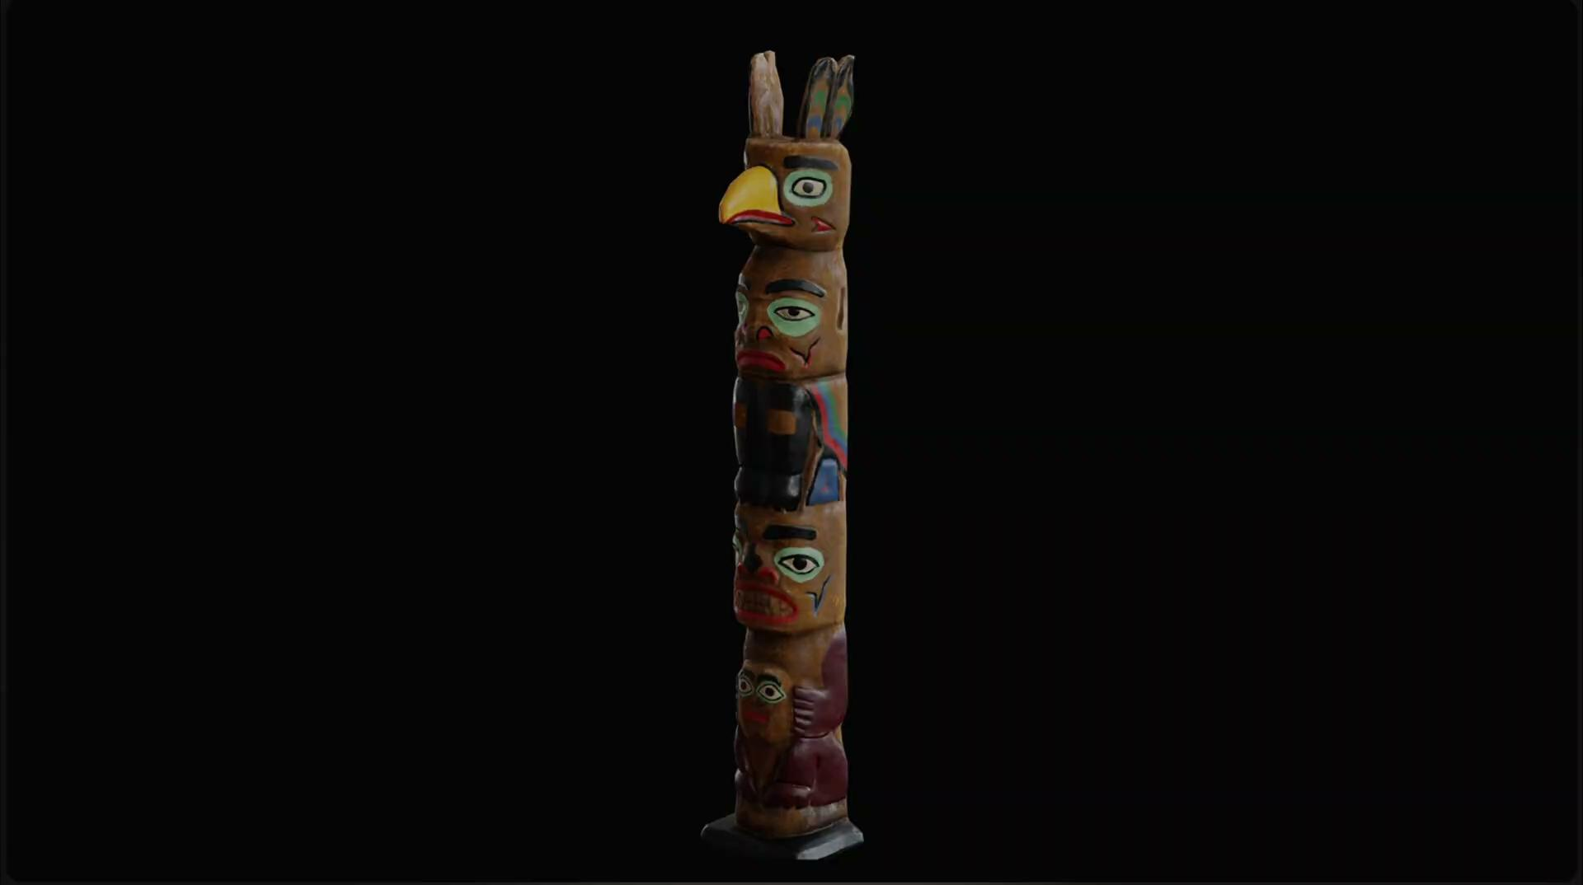
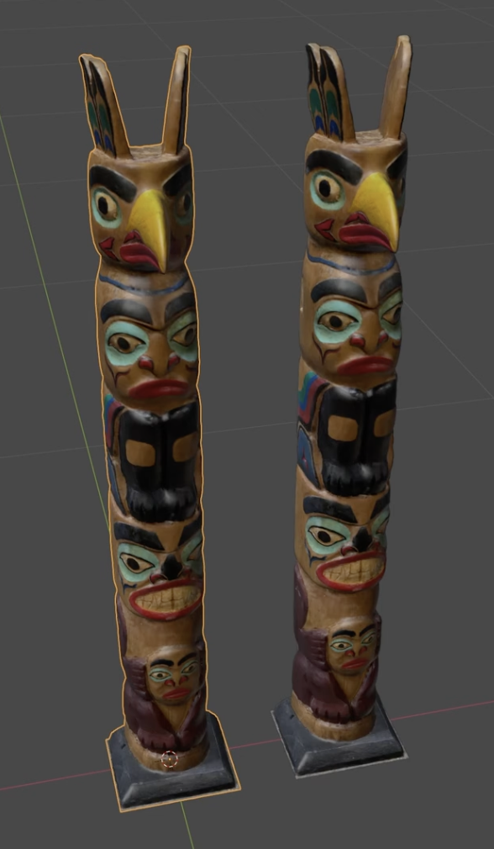
More Robust Solution -
Polycam to Blender Pipeline
Very robust and realistic
Not very user friendly compared to Adobe
How can we combine this tech with the Adobe product?
Take one photo instead of many
Convert image to SVG format
Leverage Adobe tool or make a similar one
Profit??

Slide 5

Even More Robust ??!! -
Microsoft MuseAI
Research and Development project
Spent 7 years training AI model on their game
Trained on input data + all visual frame data
Recorded everything the user input
Model can now predict what the next frames should look like based on an input
Can even model new game mechanics/input combinations w/ artwork that matches the style
Downsides:
WAY too much overhead
Difficult to acquire training data and generalize
Currently only works in low res with a couple minutes of data persistence
Doesn’t understand the game
Cool precedence for future work - could refine training models and data to make the model understand the game mechanics and architecture rather than only visual data

Slide 6
My Plan for This Project
Step 1. Research
Research Adobe technologies in-depth to understand their:
Strengths and weaknesses
Limitations in use or edge cases
Technical Implementation
Understand SVG files and how to manipulate them and derive information from them
Step 2. Development
Build my own application that models this behavior
Develop system architecture and mockups for an app based on findings
Keep it very simple 3 things it will do:
Take a photo input of an object
Convert photo to 3D model
Output useable Game Object (engine will depend on research findings as well)

Slide 7
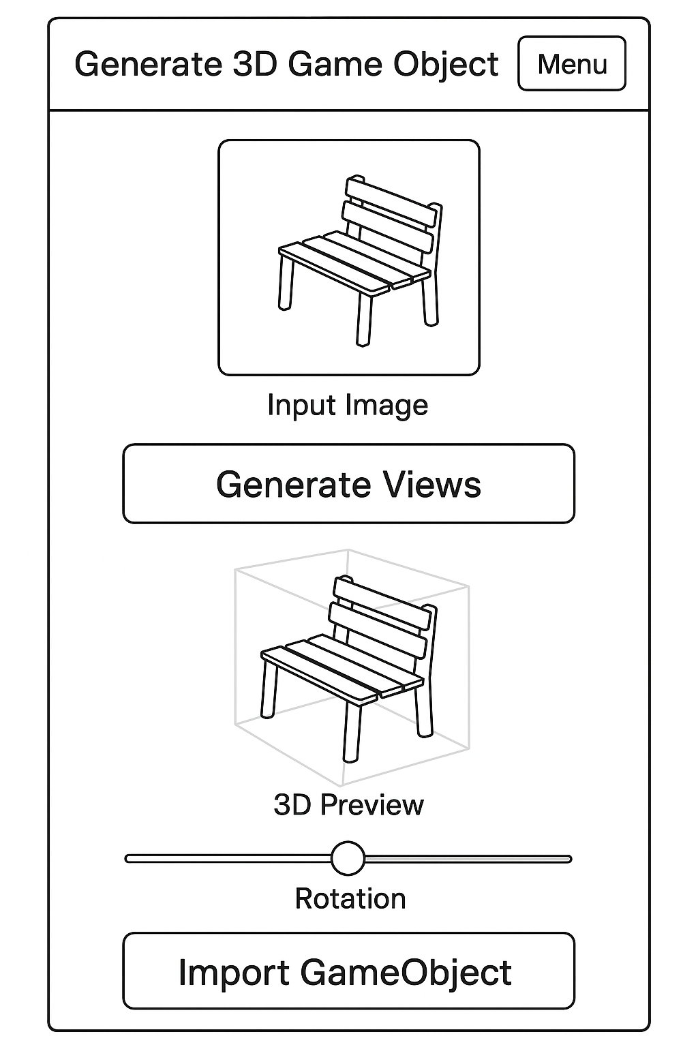
Sketch of Simple UI

Slide 8
Rough Timeline
Phase 1: Parallel Research and App Planning
November 20th: Deadline for all research to be completed
DoD: I have a strong understanding of the strengths and weaknesses, limitations, uses, and edge cases of all of these technologies and when each should be used. I understand the technical implementation well enough to make a copy of it.
November 24th: Deadline for all initial app design artifacts to be completed
DoD: I have a system architecture diagram, a user flow diagram, and detailed mockups to reference when developing my application.
Phase 2: Development and Testing
November 30th: Deadline for Testing Suite Completion
DoD: I have a set of tests to be implemented at each development stage based off of the uncovered use and edge cases found in my research.
December 4th: Deadline for app completion
DoD: I have a working application that takes an input photo file and converts it to a usable 3D model that reasonably resembles the object in the photo.

Slide 9
Risks Involved
Applications are potentially too complex to build on my own
Made by large companies with way more resources than me
Could be nearly impossible to research due to IP protection
Already having difficulty finding resources, I may need to conduct experiments to derive information instead
Rely on research that is available for 2D -> 3D conversion
Time pressure with complex implementation
Lots of my development is dependent on findings
Potential bottleneck

Slide 10
Summary of Project Proposal
Research 2D vector map (SVG) to 3D model/game object
Specifically centered on Adobe Project Neo and Project Turntable
Test the limits of the technologies available for this purpose
How are they predominantly used now?
How can they be leveraged for my purposes?
Utilize findings to build a simple application
Takes a 2D input and outputs a 3D game object
Present my findings in a research paper with discussions of extensibility
AI-enhanced pipeline for rapid iteration
Asset creation toolbox for the solo developer

Slide 11
References
[1] Adobe, “#ProjectTurntable | Adobe MAX Sneaks 2024 | Adobe,” YouTube, Oct. 16, 2024. https://www.youtube.com/watch?v=gfct0aH2COw (accessed Nov. 12, 2025).
[2] rileyb3d, “3D Game Assets From a Single Phone Scan in Blender,” YouTube, Jun. 29, 2023. https://www.youtube.com/watch?v=JbKYvLTagn0 (accessed Nov. 12, 2025).
[3] “Polycam - LiDAR 3D Scanner,” poly.cam. https://poly.cam
[4] A. Hughes, “Advancing game ideation with Muse: the first World and Human Action Model (WHAM),” Microsoft Research, Feb. 19, 2025. https://www.microsoft.com/en-us/research/blog/introducing-muse-our-first-generative-ai-model-designed-for-gameplay-ideation/ (accessed Nov. 12, 2025)

Slide 12
Thank You!
Questions?

